Slide 1
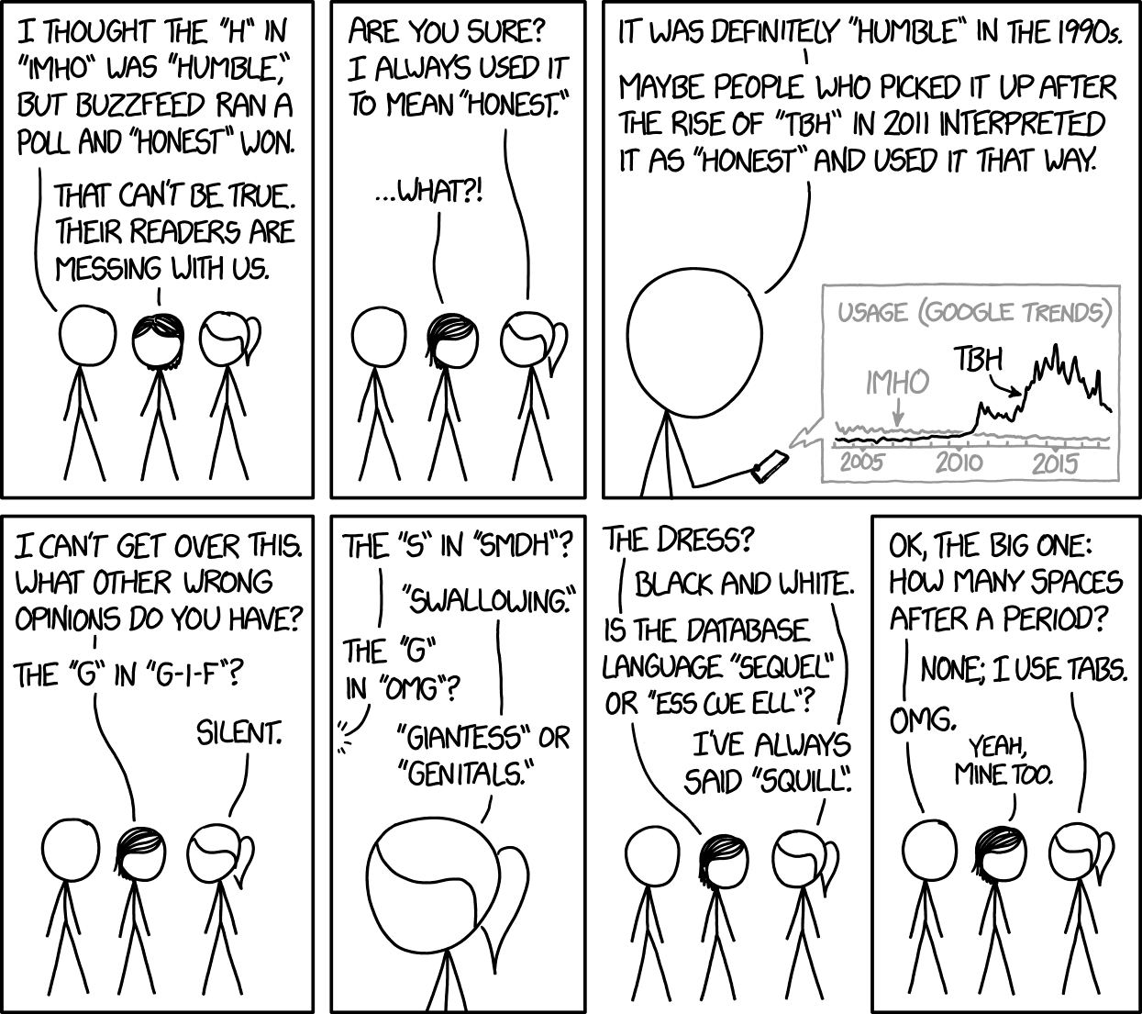
SQL

Slide 2
SQL Data
Structured Query Language
Data stored tables within databases or schema
Tables have “primary key” as unique identifiers
Or indexes that act as unique identifiers
These values also allow quick lookup
Dictionaries in Python

Slide 3
SQL overview
Structured Query Language (SQL)
Language for managing and querying data stored in relational databases
Same core syntax works across many different implementations:
SQLite — serverless and local, no installation required
Can be used directly from Python and R
MySQL/MariaDB — server-based
PostgreSQL — feature-rich, increasingly popular
Microsoft Access — legacy but still common in some areas
Cloud variants (BigQuery, Amazon Redshift) — where much production SQL is heading
Language transfers across all of these

Slide 4
Relational database
Organized by row and columns (like dataframes)
Connected via keys
Queryable as a unit

Slide 5
SQL tables and pandas
SQL and pandas organize data in fundamentally similar ways:
A SQL table ≈ a pandas DataFrame
rows are observations, columns are variables
A SQL database ≈ a collection of related DataFrames
Both support filtering, aggregation, and joining
Difference: SQL enforces relationships between tables explicitly — the database itself knows how tables connect.
Relational way of thinking about data
Notes:
In pandas you manage those relationships yourself, which puts the burden on the analyst to keep things aligned.
This is why understanding SQL is useful even if you work primarily in Python or R

Slide 6
Primary keys
uniquely identifies each row in a table.
Keys can be:
Natural — something meaningful that already exists in the data (country code, ISBN)
Surrogate — an arbitrary ID assigned purely for database purposes (auto-increment integer)
Composite — two or more columns together form a unique identifier (country + year)

Slide 7
Unique identifiers
SQL: explicit about unique identifiers
good practice regardless of the tool you are using.
In SQL, primary key
Choosing a unique identifier: what does one row represent?
Row number not informative.
Country-year identifier more informative
tells you exactly what the observation is
makes merges meaningful and reliable.
Should adopt behavior in dataframes.

Slide 8
Database keys
Database keys: data structure that allows fast lookup of rows by key value
Rather than scanning every row, the database jumps directly to the right location.
Works across millions of rows stored on disk
Similar to Python dictionaries or JSON data
Use key to retrieve a value in O(1) time
By contrast, dataframes retrieve values in O(n) time where n is number of dataframe rows
Notes:
Big O notation – how an algorithms run time changes as input increases

Slide 9
Python dictionaries
Key–value structure: keys are unique identifiers and values are the data associated with them. Access values by key: my_dict['name'] returns the value for 'name’.
Flexible keys and values:
Keys must be immutable (e.g., strings, numbers, tuples)
Values can be anything
No fixed schema:
No predefined columns (unlike SQL tables)
different keys can exist across entries (similar to JSON).
Nested and hierarchical
Can contain other dictionaries (multilevel)

Slide 10
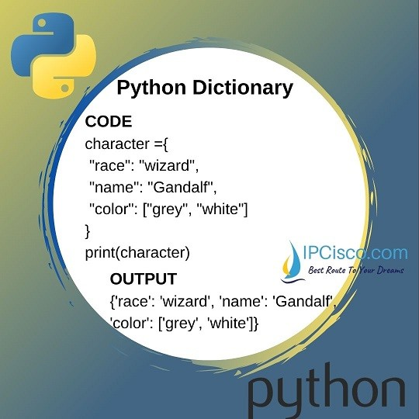
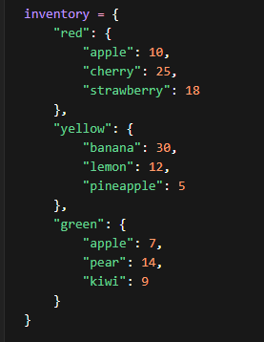
Dictionary structure

Slide 11
Json v. relational database
Json: hierarchical and nested structure
SQL: relational with flat tables
Flat- two dimensional (rows and columns)
Dataframes: Flat structure and self-imposed relations
JSON represents a different philosophy from SQL — hierarchical and nested rather than relational and flat. We will return to JSON in a later week, but it is worth noting here that the key-value idea connecting dictionaries, indexes, and JSON is one of the organizing concepts of modern data structures.

Slide 12
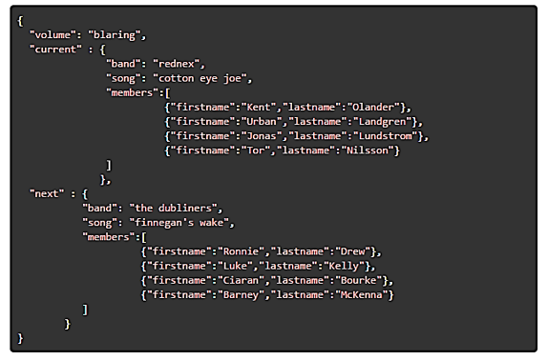
JSON structure

Slide 13
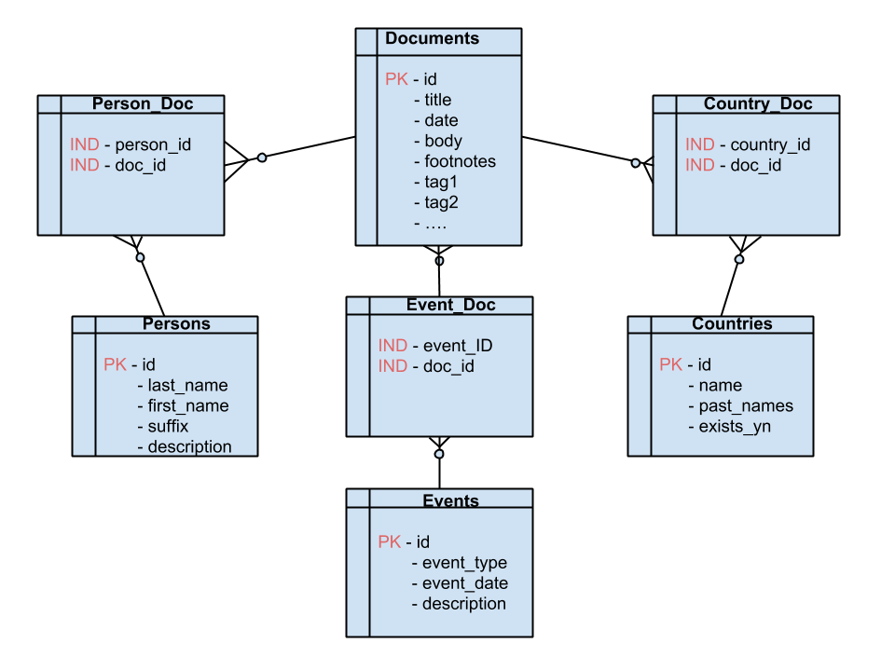
SQL Database structure

Slide 14
Why multiple tables?
Issues with one big table:
Size — the table becomes unwieldy very quickly
Redundancy — if a country appears in 1,000 documents, its name, region, and population get repeated 1,000 times
Update anomalies — if a country's capital changes, you have to update 1,000 rows instead of one
Multiple rows per document — a document mentioning three countries needs three rows, which breaks the one-row-per-observation principle we stressed earlier

Slide 15
Walkthrough tables
Tables within database linked by primary keys and composite keys
Documents:
id serves as primary key with other columns as indicators
Persons:
id serves as primary with other columns as indicators
Person_doc:
Links records in documents and in persons
Doc_id is id from documents
person_id is id from persons

Slide 16
Relation to sparse matrices
Both ways to minimize data size
Sparse matrix—most features missing in most documents so lots of 0 in matrix
SQL—repeated data across observations

Slide 17
Using SQL

Slide 18
Querying database
Focus here on retrieving data from existing databases
SELECT columns FROM table;
SELECT – Retrieve columns from table
columns - columns to retrieve
Use an asterisk (*) to select all columns
FROM table – which table are we selecting data from
Use “.” to separate namespaces (schema from table--frus.docs or table from column--docs.id)

Slide 19
Qualifiers
Ways to limit or restrict query
WHERE – Restrict query to cases where condition is met
SELECT id, date, body FROM docs WHERE body regexp 'TRADE';
SELECT id, date FROM docs WHERE year(date)=1955;
LIMIT
SELECT id, date, body FROM docs WHERE body regexp 'TRADE‘ LIMIT 10;

Slide 20
More functions
Counts
Aggregate SQL data before returning data
Requires GROUP BY option
SELECT count(id), year(date) FROM docs GROUP BY year(date);
ORDER BY
Sorts results of SELECT query by column(s)
Ascending order by default

Slide 21
Joins
Select columns from multiple tables
Similar to merge in R/Python
SELECT country_id, doc_id, countries.name from country_doc INNER JOIN countries ON country_doc.country_id= countries.id;

Slide 22
Joins
Similar to pandas merge
INNER join
Returns records with matching values in each table
OUTER join
Returns all records whether matched or not
LEFT join
Returns all records from table 1 and matched records from table 2
RIGHT join
Returns all records from table 2 and matched records from table 1

Slide 23
Can get complicated
Count of FRUS documents by country and year with country name
SELECT count(doc_id), country_id, max(name), year(tr.date) FROM countries INNER JOIN country_doc ON countries.id = country_doc.country_id INNER JOIN (SELECT id, date FROM docs WHERE body regexp 'TRADE') tr ON country_doc.doc_id = tr.id GROUP by country_id, year(tr.date);

Slide 24
SQL tips
Specify table a field is from with the field
INNER JOIN country_doc ON countries.id = country_doc.country_id
Similar to R: country_doc$country_id; countries.id
Label multiple select queries
(SELECT id, date FROM docs WHERE body regexp 'TRADE') tr
Necessary if you want to restrict query
Not necessary if you don’t
Parentheses make code easier to understand

